Slide 1
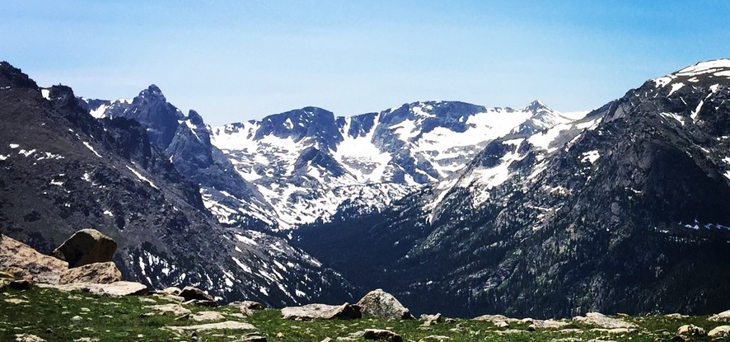
Geodesy and GPS
UNM Earth Sciences Computing & Programming Experience, Aug 8 – 19, 2022
Eric Lindsey, Lindsay Worthington, Brandon Schmandt, Mousumi Roy, Jeng Hann Chong, Evans Onyango

Slide 2
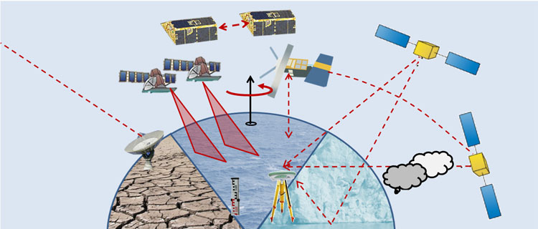
What is Geodesy?
Geodesy is the study of the shape and size of the Earth, its gravity field, its rotation, and how these things change over time.
This simple goal means that we study the kinematics, dynamics, of and interaction of processes among, solid earth, cryosphere, hydrosphere, atmosphere, and biosphere.

Slide 3
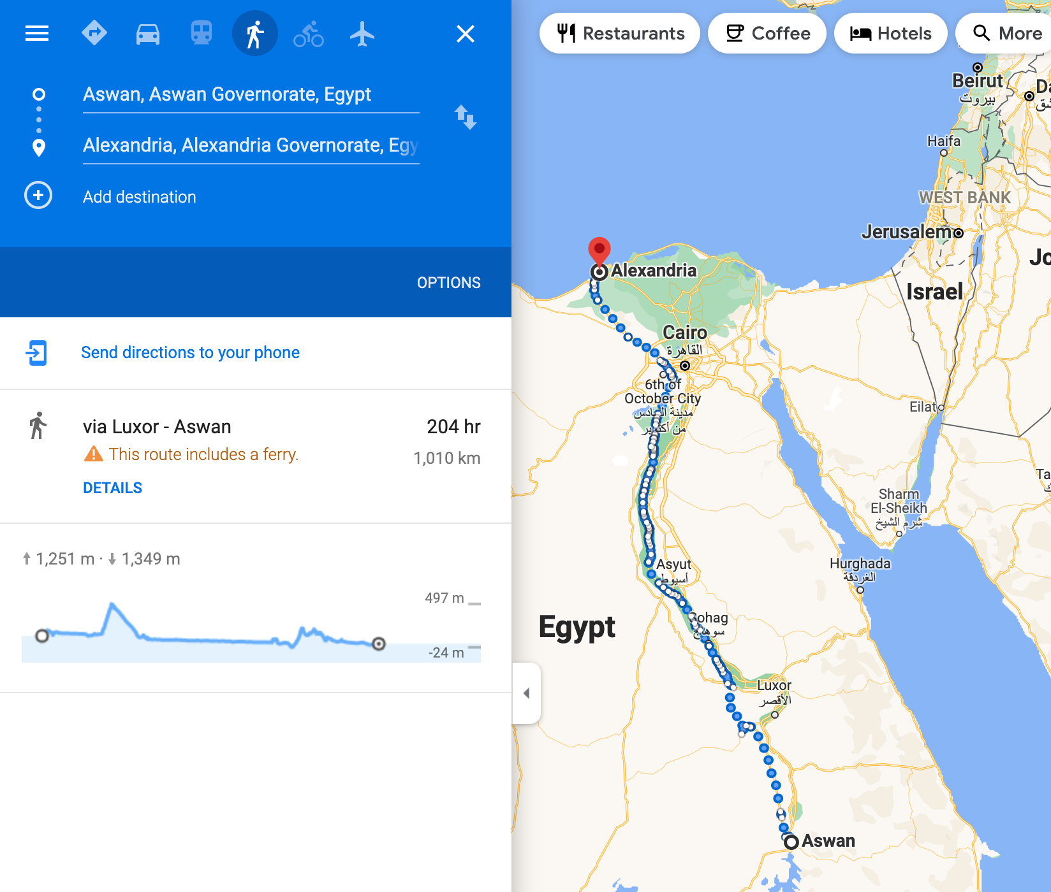
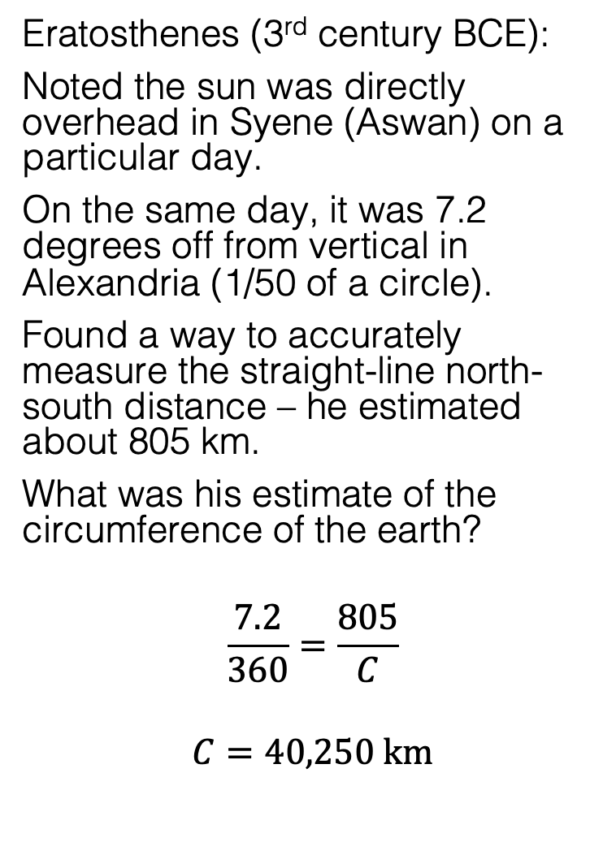
Very early development
Eratosthenes (3rd century BCE):
Noted the sun was directly overhead in Syene (Aswan) on a particular day.
On the same day, it was 7.2 degrees off from vertical in Alexandria (1/50 of a circle).
Found a way to accurately measure the straight-line north-south distance – he estimated about 805 km.
What was his estimate of the circumference of the earth?
$$\frac{7.2}{360}=\frac{805}{C}$$
$$C=40,250 km$$

Slide 4
Today’s values
Polar circumference: 40,007.863 km
Note: the meter was originally defined so that there were 10,000 km between the equator and the pole! (It is also ~21,600 nautical miles for the same reason; 1 nm is equal to 1/60 of a degree.)
Equatorial circumference: 40,075.017 km
Equatorial Radius: 6378 km
Polar Radius: 6357 km
Sphere of Equal Volume: 6371 km
Flattening: (a-b)/a: 1/298.257223563
Illustration of Earth’s oblateness – to scale

Slide 5
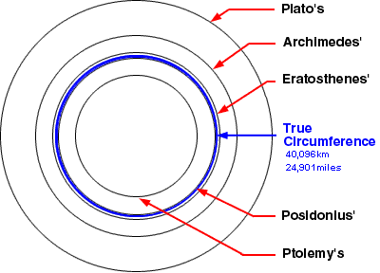
Very early development
Despite some errors in the measurement, Eratosthenes was off by only ~0.5%!
There were many early Greek attempts to measure the circumference, and we like to cite Eratosthenes because he was most accurate – but this could have been chance.

Slide 6
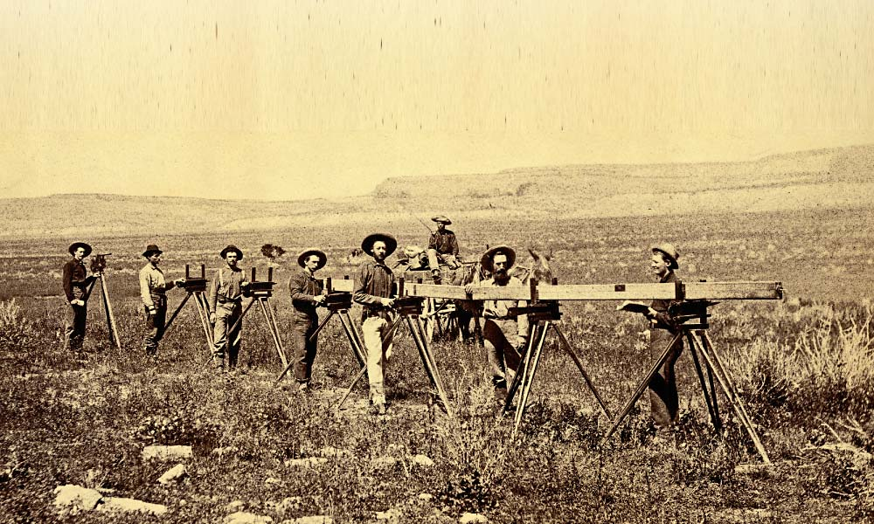
USGS Chainmen, New Mexico 1883 – Library of Congress

Slide 7
Measuring the baseline
Count the number of boards along a path as straight & level as possible, as many times as it takes to get to the next marker.
USGS Chainmen, New Mexico 1883 – Library of Congress

Slide 8
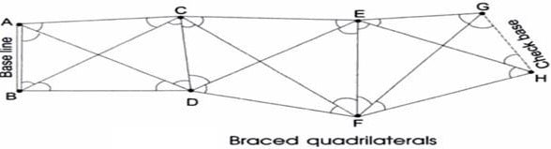
Triangulation – basic idea
If we measure one side length and a bunch of angles, we can determine all the lengths with some trigonometry.
This is good because angles are usually much easier to measure than side lengths!

Slide 9

Not always a peaceful history
Surveys in the US and by colonial powers globally were generally aimed at seizing land or creating maps & infrastructure to help others do so.
The history of geodesy is tied up in our racist & imperialist past. As Earth scientists and practitioners, we should remember this, and work to make amends.
Extra reading – A history of public lands in the US, from the Wilderness Society. It is a painful but important part of history for us to remember as geoscientists.
https://www.wilderness.org/public-lands-curriculum

Slide 10
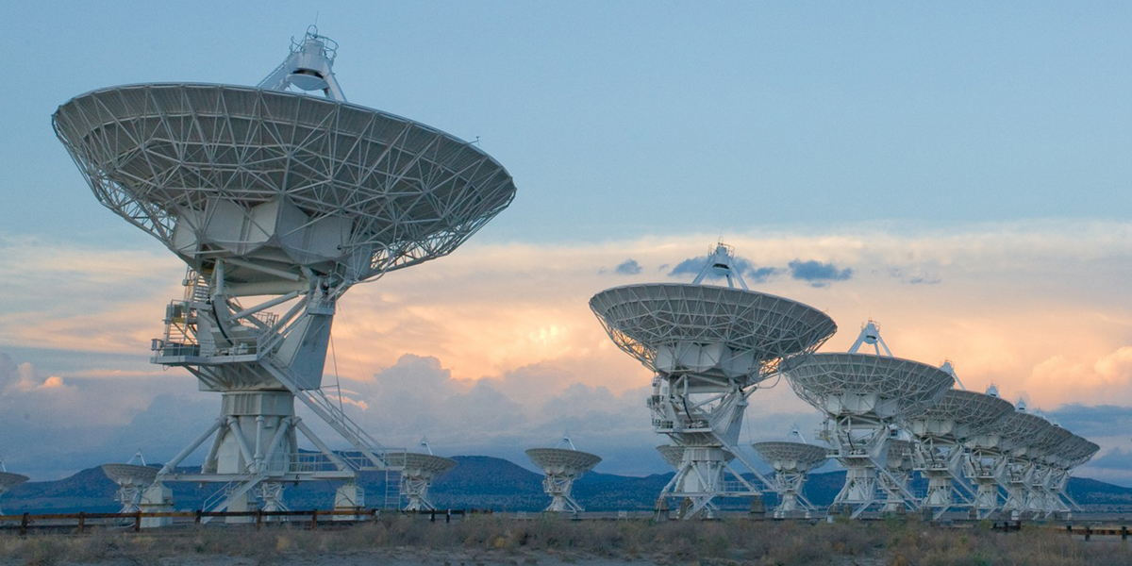
Very Long Baseline Interferometry
If we could combine the data from all these telescopes simultaneously, what would be the effective aperture D ?

Slide 11
Very Long Baseline Interferometry
If we could combine the data from all these telescopes simultaneously, what would be the effective aperture D ?
Answer: D is roughly the largest distance between any two dishes, so the farther apart they are, the better our image (with some caveats).

Slide 12
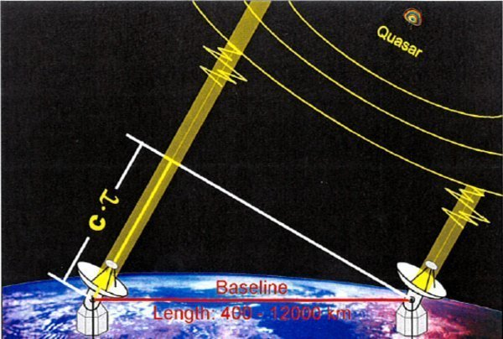
Very Long Baseline Interferometry
Crazy idea: let’s put dishes on opposite sides of a continent.
To combine the signals coherently, we need to know the distance between them.
Max Planck Institute

Slide 13
Very Long Baseline Interferometry
Crazy idea: let’s put dishes on opposite sides of a continent.
To combine the signals coherently, we need to know the distance between them.
Crazier(?) idea: use the signal to determine the distance!
Max Planck Institute

Slide 14
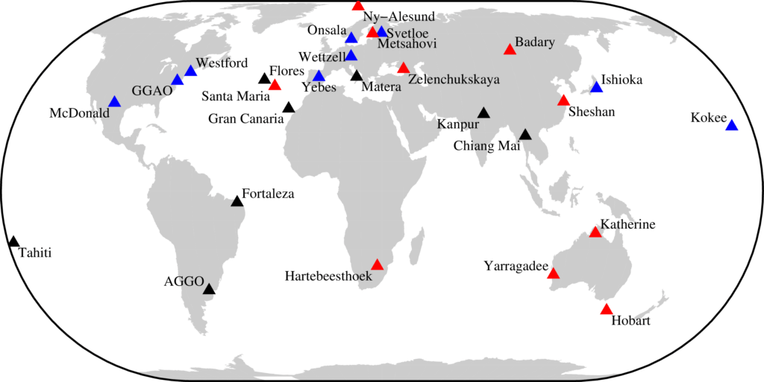
Very Long Baseline Interferometry – modern network

Slide 15
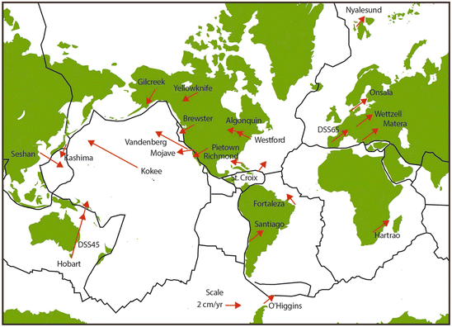
VLBI – Geodesy results
Whitney et al., 2014 – plate motions from VLBI

Slide 16
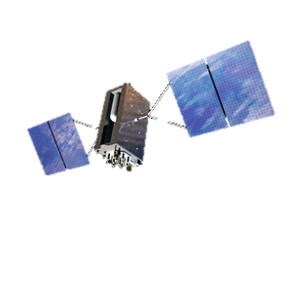
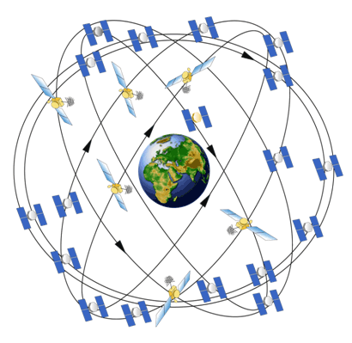
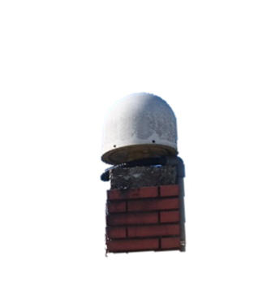
NAVSTAR: GPS Satellite Network
Navigation System with Time And Ranging Global Positioning System
First satellite launched in 1978
First satellite system to carry an atomic clock in space
Currently 32 operational satellites in orbit
Global 2-D positioning in 1991
Global 3-D positioning in 1993
Fully operational in 1995

Slide 17
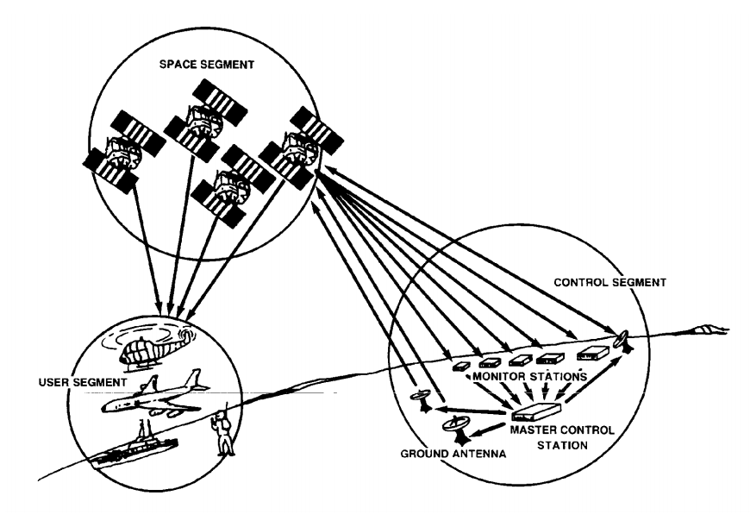
Major system segments of GPS
Space segment
Control segment
User segment
https://www.navcen.uscg.gov/pubs/gps/gpsuser/gpsuser.pdf

Slide 18
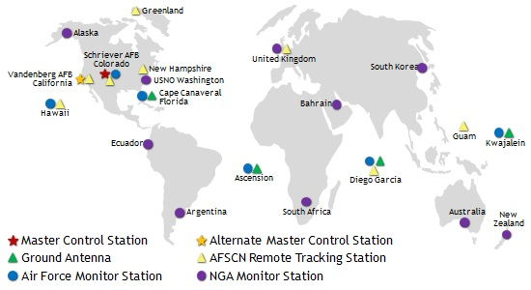
GPS control infrastructure: US Military
https://www.losangeles.af.mil/News/Article-Display/Article/734612/masters-of-space-keep-gps-constellation-grounded-and-on-time/

Slide 19
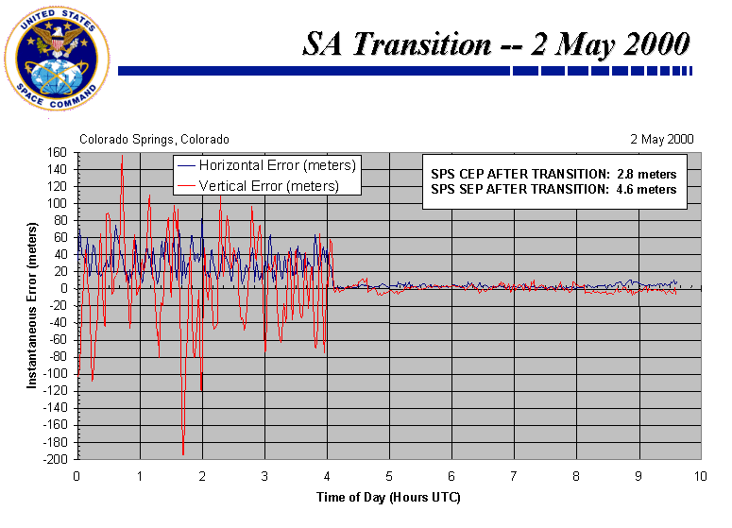
Selective availability
S/A added an extra noise component to the signal - only users with the cryptographic key could remove this noise. This feature was permanently turned off in 2000; new satellites do not have this ability.

Slide 20
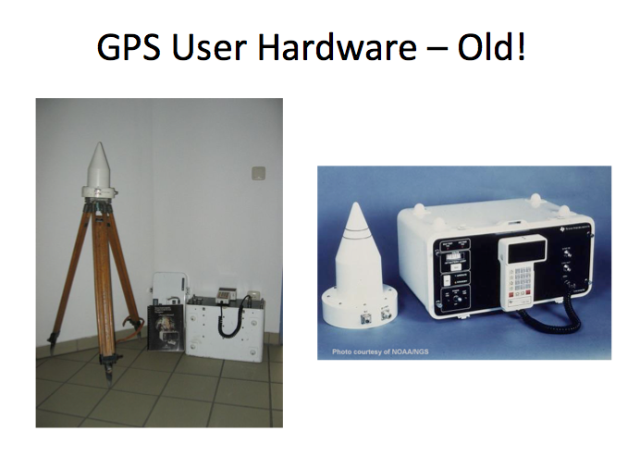
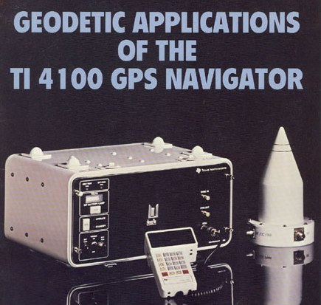
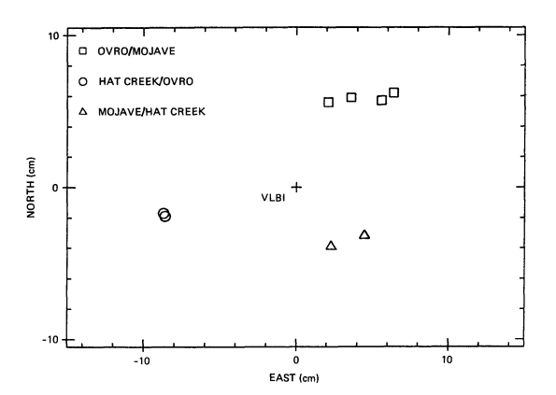
First commercial GPS receiver (1981)
Baseline difference between GPS and VLBI measurement by JPL in 1984 using TI 4100 GPS (Davidson et al., 1985)

Slide 21
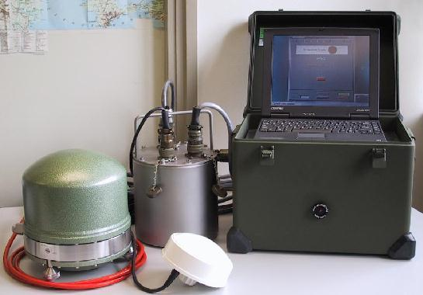
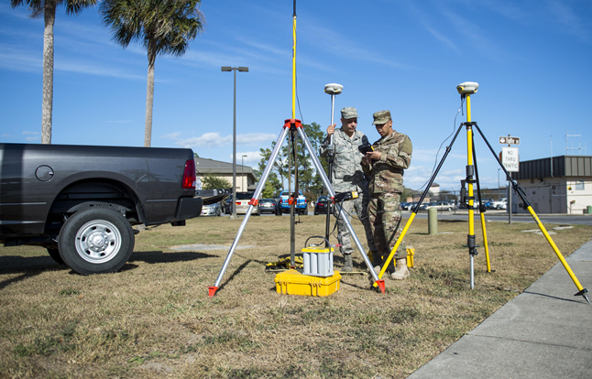
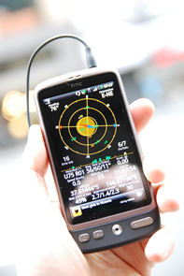
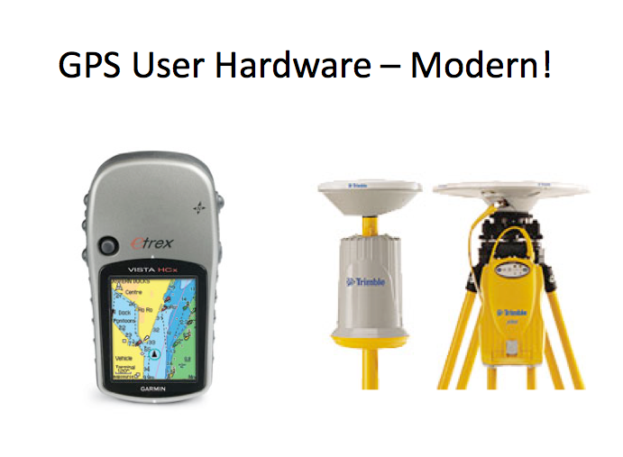
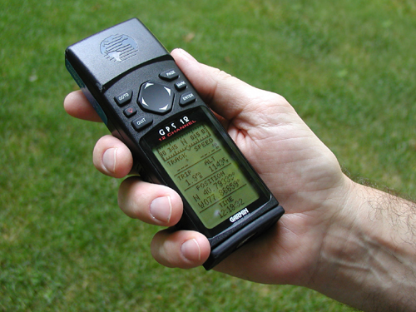
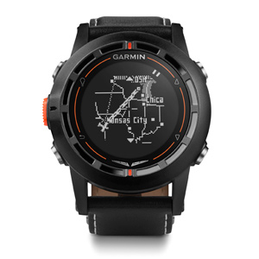
Modern GPS receivers
http://www.geo.uu.nl/Research/Seismology/baja_equipment.html

Slide 22
Other GNSS systems
Other than GPS developed by U.S.A, currently there are other satellite constellation provide positioning determination and GNSS service, these systems include:
GLONASS (Russia)
Galileo (European Union)
Beidou (China)
NAVIC (India)
QZSS (Japan)

Slide 23
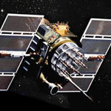
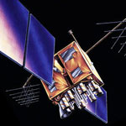
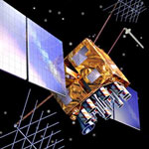
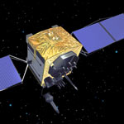
GPS
6 orbital planes
31 operational satellites 55 deg inclination angle
Passive system to the user
LEGACY SATELLITES |  | MODERNIZED SATELLITES
BLOCK IIA | BLOCK IIR | BLOCK IIR-M | BLOCK IIF | GPS III/IIIF
0 operational | 8 operational | 7 operational | 12 operational | 4 operational
C/A code on L1 for civil users P(Y) code on L1 & L2 for military Launched in 1990-1997 | C/A on L1, P(Y) on L1 & L2 On-board clock monitoring Launched in 1997-2004 | 2nd civil signal on L2 (L2C) Flexible power levels for military signals Launched in 2005-2009 | 3rd civil signal on L5 frequency (L5) Advanced atomic clocks Launched in 2010-2016 | 4th civil signal on L1 (L1C) No Selective Availability First launch in 2018
Orbit height: 20200 km
(1/2 sidereal day period)
Frequency: 1575.42 MHz (L1) 1227.6 0MHz (L2) 1176.45 MHz (L5)
https://www.gps.gov/systems/gps/space/

Slide 24
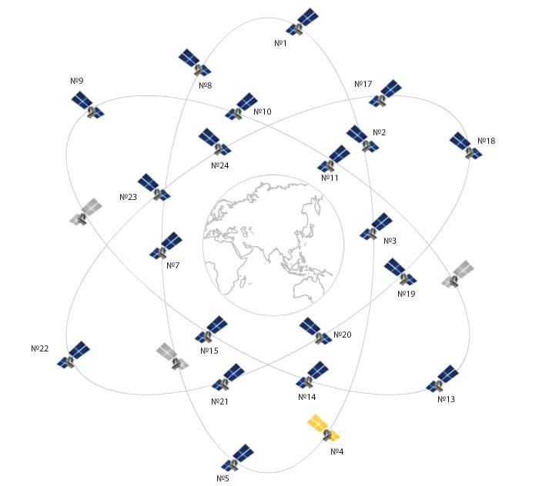
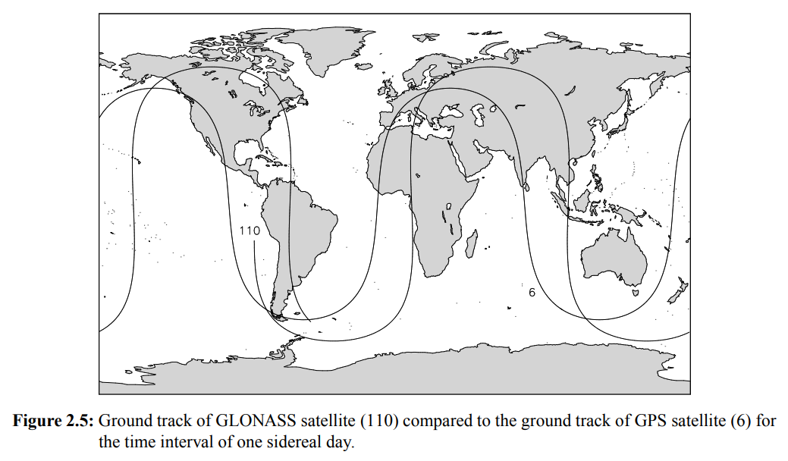
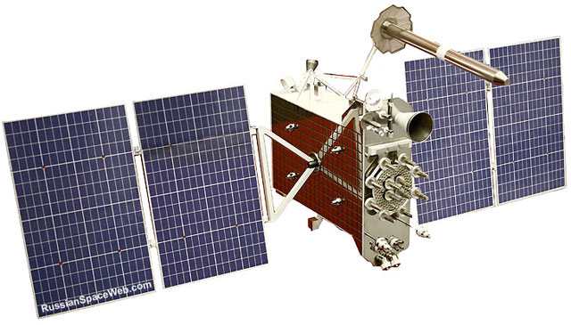
GLONASS
3 orbital planes
23 operational (total 27)
Orbit height ~19100 km
64.8 deg inclination angle
Circular orbit
GLONASS-K
GLONASS’s ground track
Bernese GPS Software Version 4.2 Page 13

Slide 25
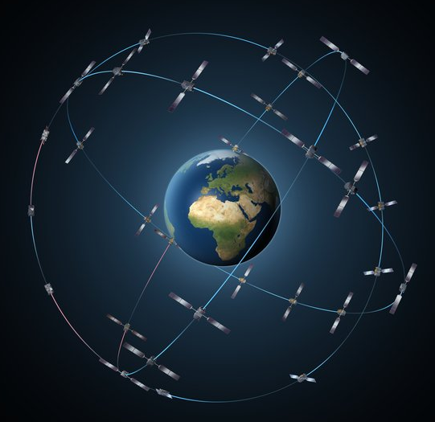
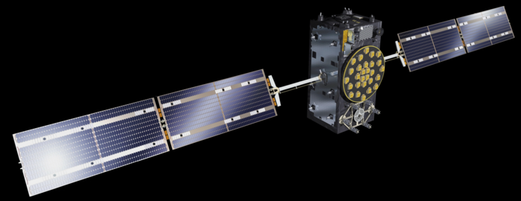
Galileo
3 orbital planes
24 operational (total 26)
Orbit height ~23200 km
56 deg inclination angle
Circular orbit
Initial services started on December 15th, 2016
Expected full operation by 2020
Better coverage at high latitude than GPS
When Galileo is combined with GPS, availability and position accuracy should be significantly improved in the urban environment.

Slide 26
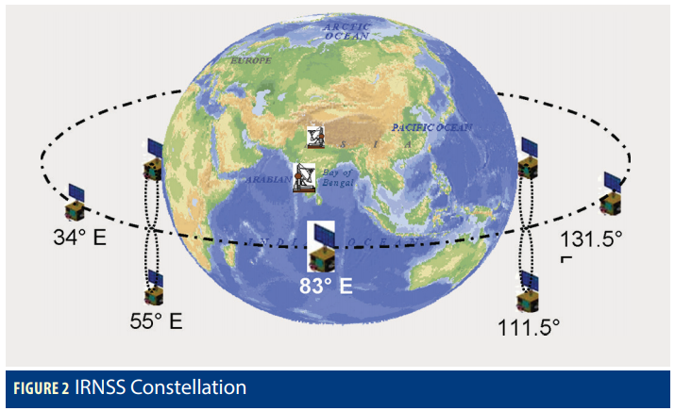
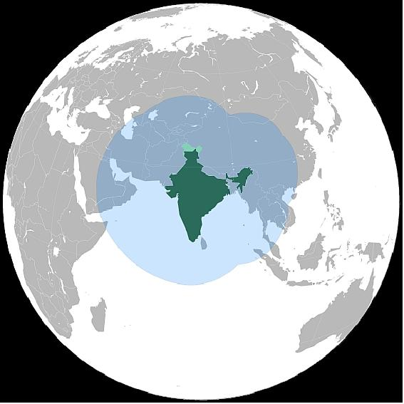
NAVIC (IRNSS)
GEO; IGSO orbits
7 operational
Circular orbit
 | GEO | IGSO
a (km) | 42164 | 42164
e | 0 | 0
Inclination | 0 | 29
Planes | 1 | 2
IRNSS uses different frequency to the GPS system (L & S Band)
https://insidegnss.com/auto/julyaug17-IRNSS.pdf

Slide 27
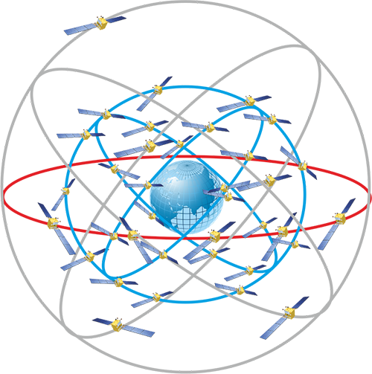
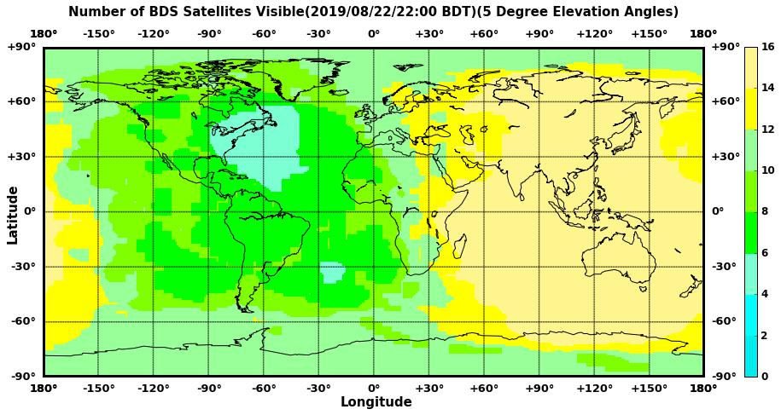
Beidou (COMPASS)
BDS-2 & BDS-3
GEO; IGSO; MEO orbits
49 operational
Circular orbit
 | GEO | IGSO | MEO
a (km) | 42164 | 42164 | 27878
e | 0 | 0 | 0
Inclination | 0 | 55 | 55
Planes | 1 | 3 | 3
https://www.glonass-iac.ru/en/guide/beidou.php
http://en.beidou.gov.cn/SYSTEMS/Monitoringandevaluation/
http://www.csno-tarc.cn/system/constellation

Slide 28
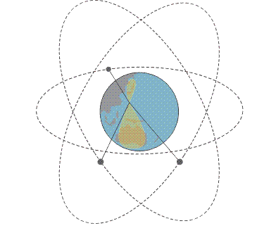
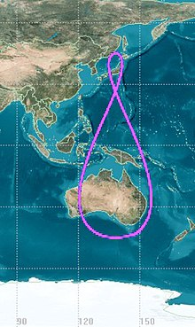
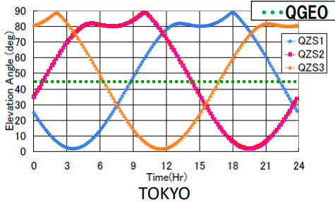
QZSS (Quasi-Zenith Satellite System)
GEO; IEGSO (QZ)orbits
4 operational (1 GEO; 3 QZ)
Elliptic orbit
Visibility of QZSS satellites at Tokyo
 | GEO | QZ
a (km) | 42164 | 42164
e | 0 | 0.075
Inclination | 0 | ~41
Planes | 1 | 3
http://www.unoosa.org/documents/pdf/icg/2017/01_icg12.pdf
http://www.unoosa.org/documents/pdf/icg/2018/ait-gnss/11_QZSS_Update.pdf

Slide 29
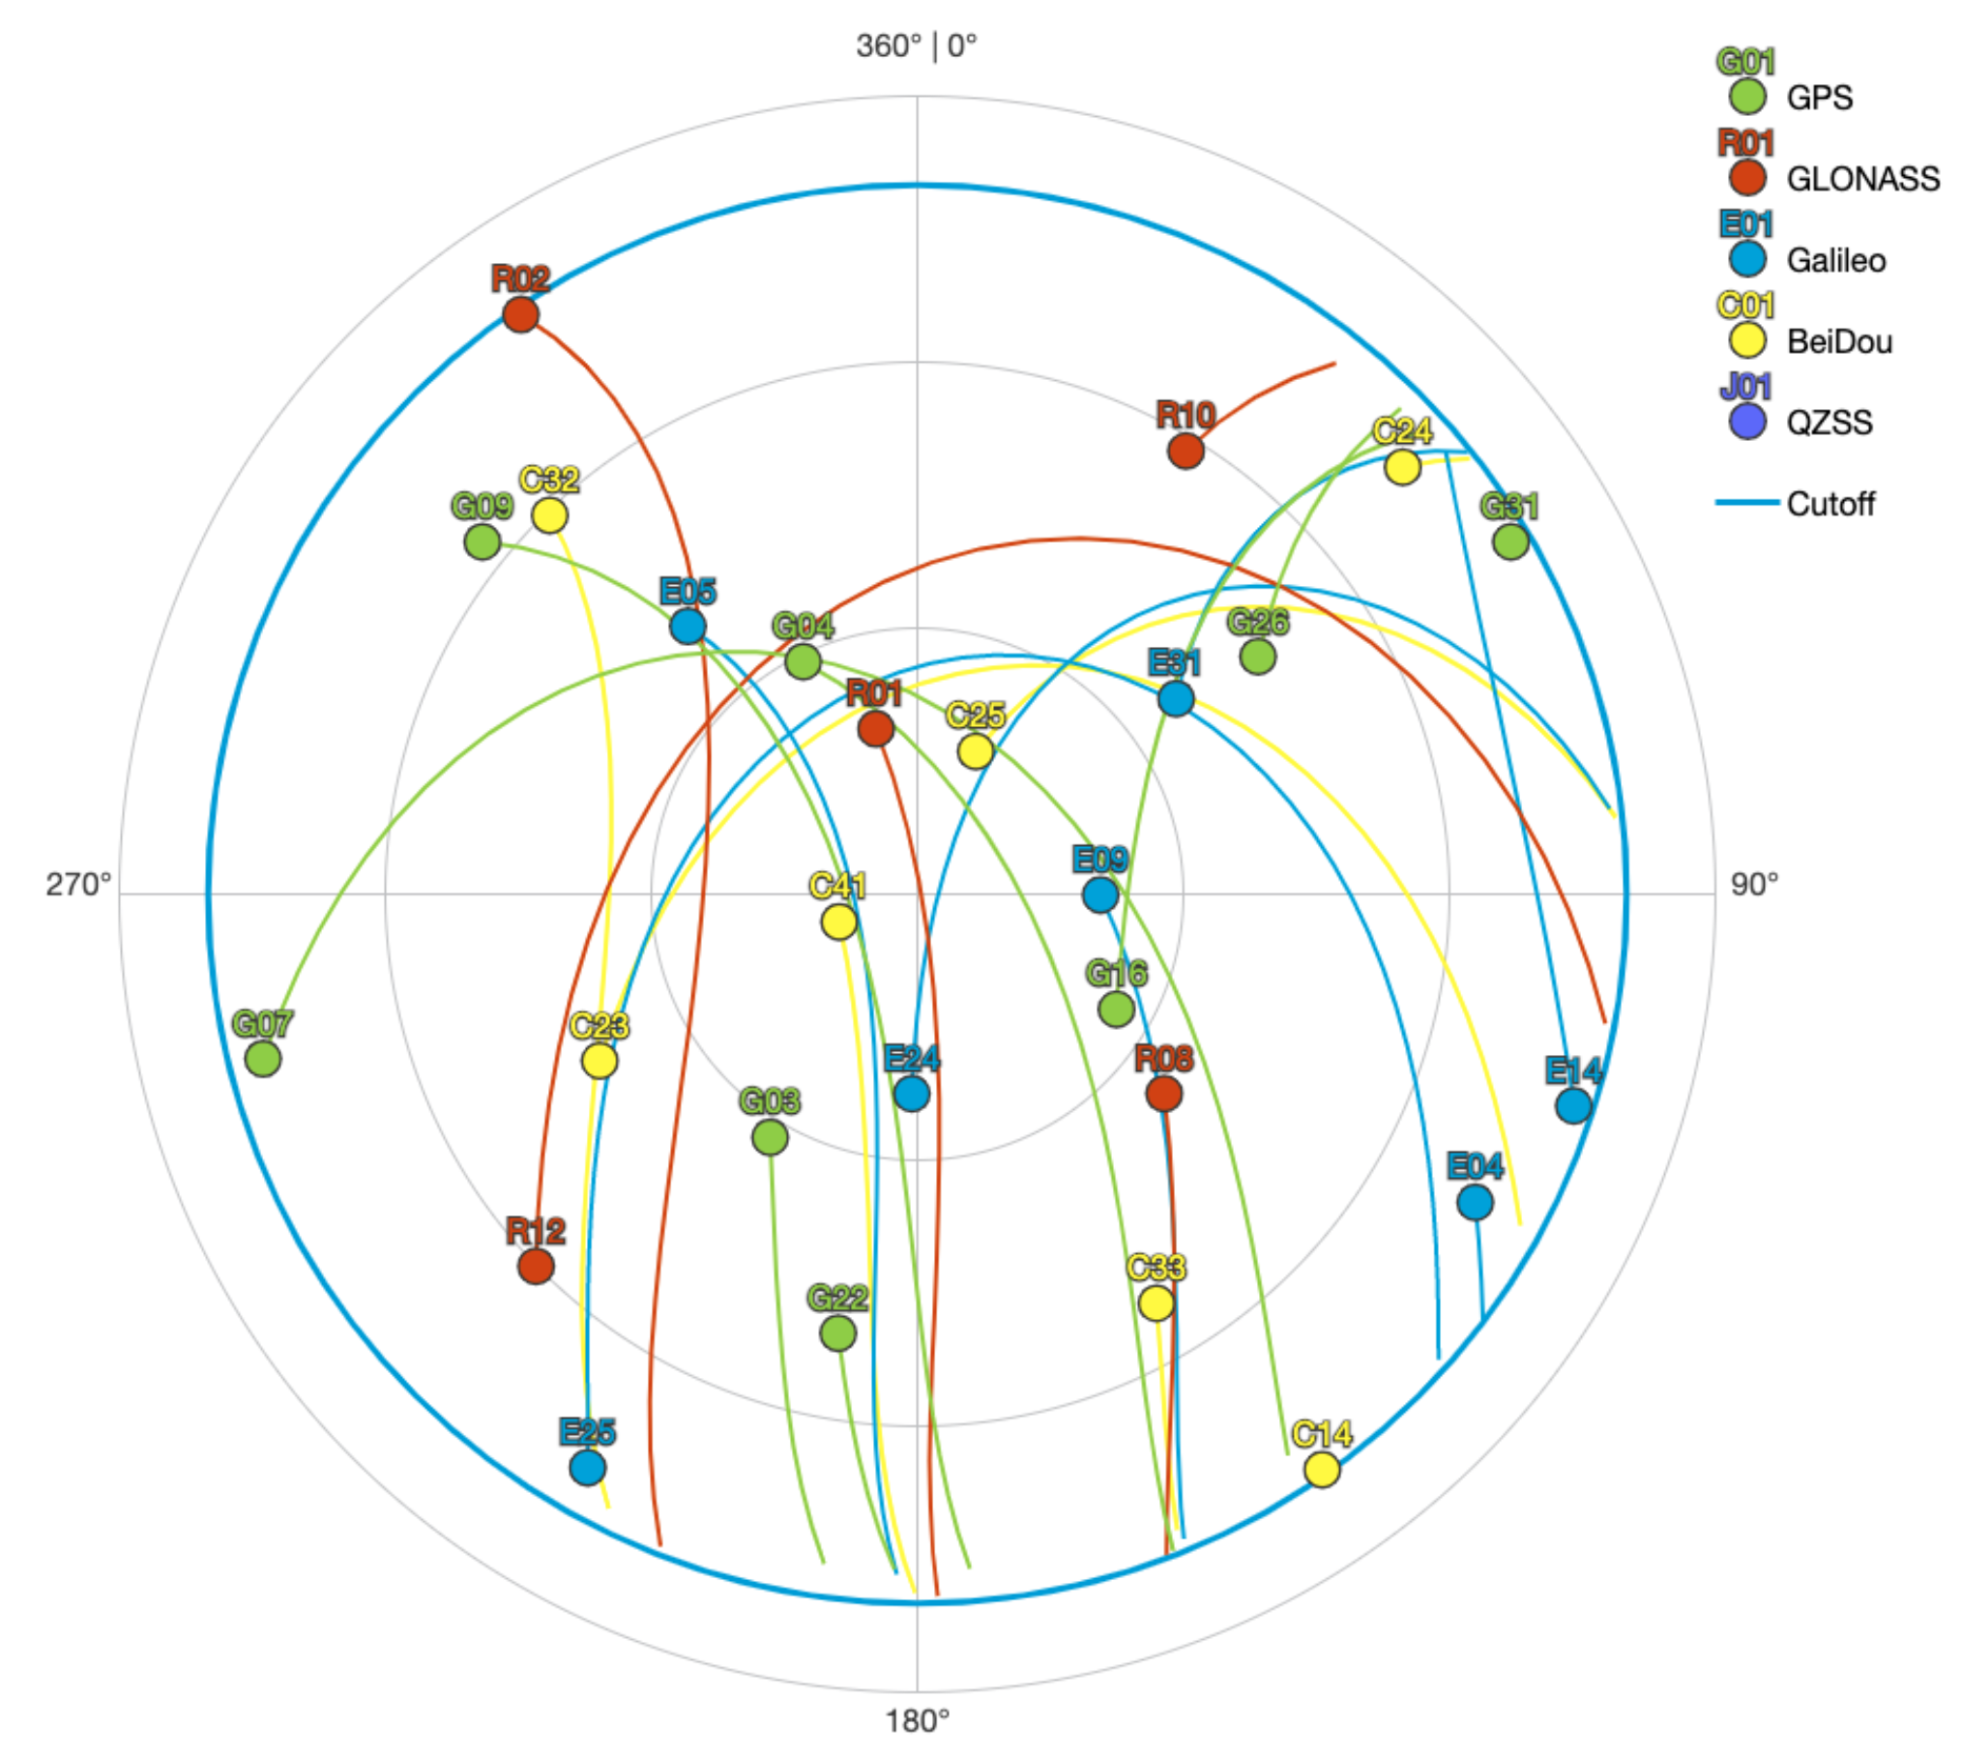
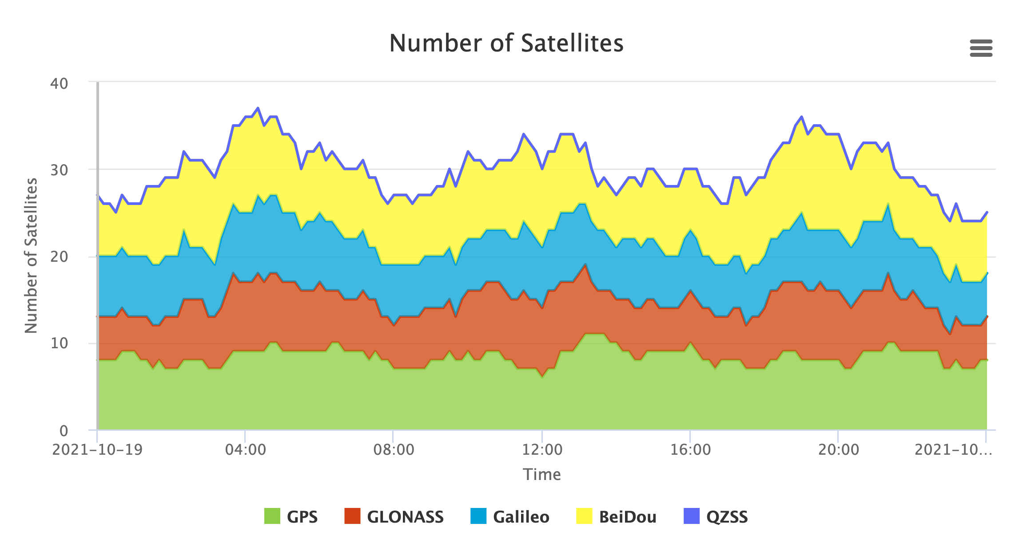
How many satellites are visible?
Location: Albuquerque
gnssplanning.com

Slide 30
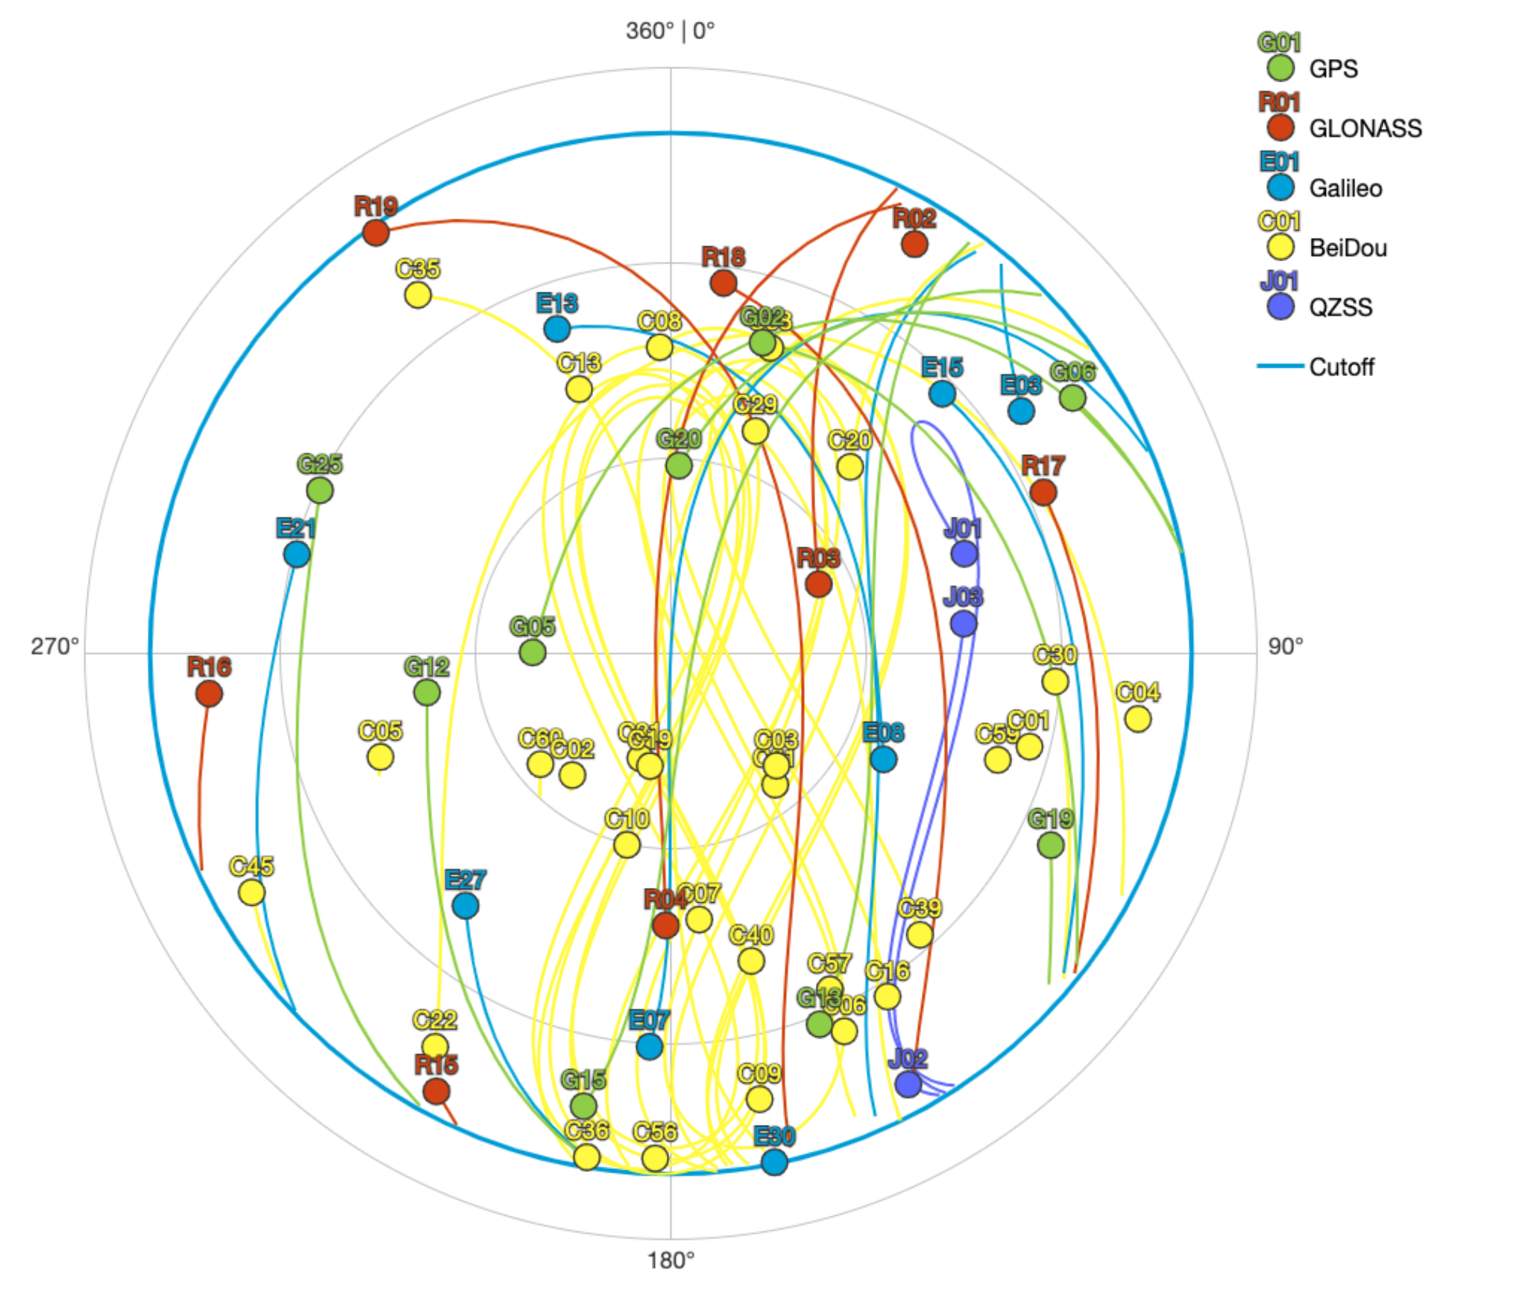
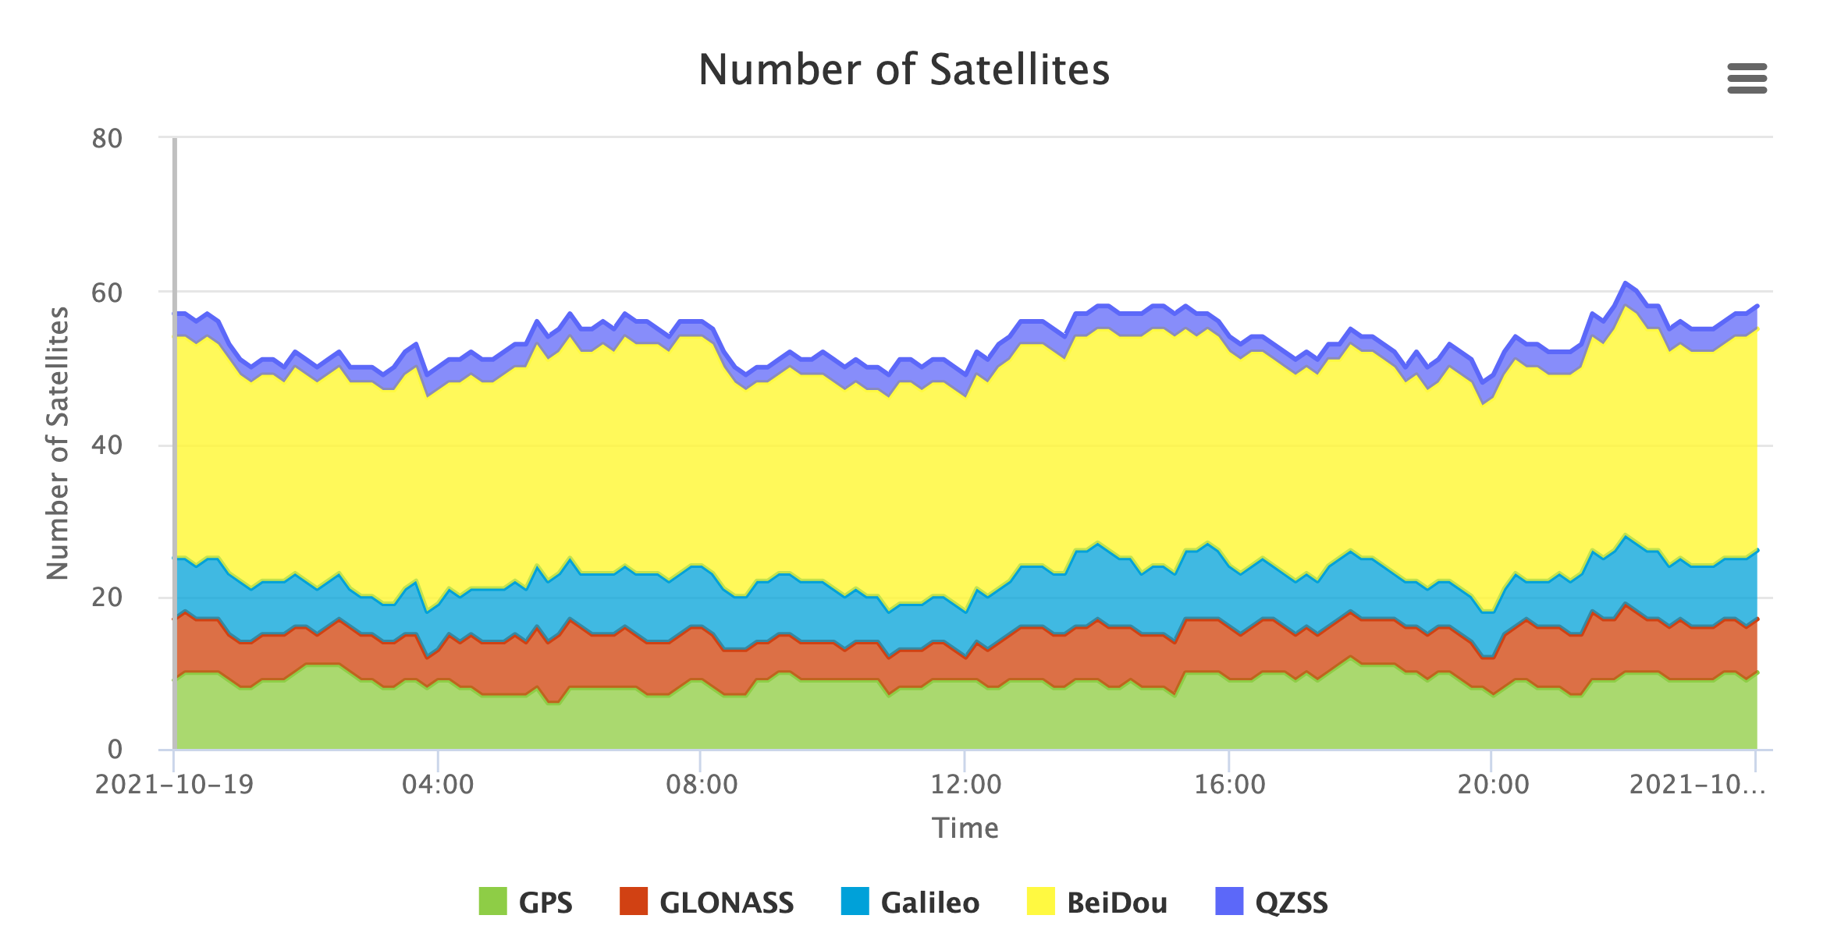
How many satellites are visible?
Location: Yangon (Myanmar)
gnssplanning.com

Slide 31
How does a receiver estimate its position & velocity?
Your location is:
37º 23.323’ N
122º 02.162’ W
Notes:
Since each satellite maintains time very accurately (~1 nanosecond = 30 cm), it can tag its signal with the time of transmission. This information, together with the location of the satellite, also transmitted to the receiver, is sufficient to allow the receiver to calculate the range to each satellite provided that the receiver also knows also knows the time. Equipping receivers with atomic clocks would be very expensive, so the receiver tags the signal with the time of its internal clock to create a “pseudorange” (range plus an unknown clock correction). The software in the receiver then uses the pseudoranges from four satellites to solve for the four unknowns: three coordinates and the receiver clock correction. These solution are good to only the 1 meter level, at best, due to the imprecision of pseudoranges, so we used them in GAMIT only to get initial approximate coordinates for sites, and, when positions are known, to get the receiver clock correction (1 m = 3 ns, and we need only 100 microsecond accuracy to get sub-mm accuracy in differential lpositioning.)

Slide 32
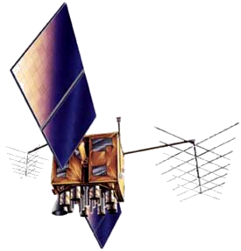
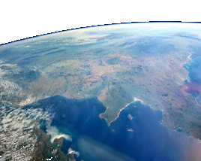
Time of arrival: calculating distance
T_{i}
Receiver-generated
dt
Satellite-received
T_{i}
T_{r}
~ 20,200 km
T_{r}
Notes:
Code modulated onto two L-band (approximately microwave) carrier frequencies. Code sent from satellite and generated in receiver at time T. Signal received at time T+t. Difference is travel time, t.

Slide 33
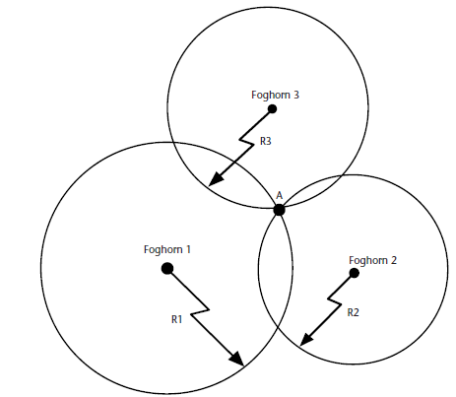
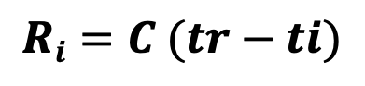
Time of Arrival (TOA) ranging
Example: A simple 2-D measurement
TOA ranging Measuring the time it takes from the signal source at a known location to the receiver
$$Ri=C (tr−ti)$$
V ~ 3 × 10⁸ m/s

Slide 34



Time of Arrival (TOA) ranging
$$Ri=C (tr−ti)$$
With 1 satellite, we only know how far away we are from it
$$Ri=\sqrt{(Xi−X)2+{(Yi−Y)}^{2}+{(Zi−Z)}^{2}}$$
V ~ 3 × 10⁸ m/s

Slide 35

Time of Arrival (TOA) ranging
$$Ri=C (tr−ti)$$
With 2 satellites, we still have a circle of several possible locations
$$Ri=\sqrt{(Xi−X)2+{(Yi−Y)}^{2}+{(Zi−Z)}^{2}}$$
V ~ 3 × 10⁸ m/s

Slide 36

Time of Arrival (TOA) ranging
$$Ri=C (tr−ti)$$
With 3 satellites, we can find a true and a false location (2d fix)…
But there may be other parameters to resolve...
$$Ri=\sqrt{(Xi−X)2+{(Yi−Y)}^{2}+{(Zi−Z)}^{2}}$$
V ~ 3 × 10⁸ m/s

Slide 37


Time of Arrival (TOA) ranging
$$Ri=C (tr−ti)$$
$Ri=Range(X,Y,Z)$ + C(dt) + others
The receiver's time may be different to the GPS time!
Clock offset
All other delays and offsets
One more GPS ranging information is needed to estimate the clock offset
V ~ 3 × 10⁸ m/s

Slide 38




Atmospheric structure
Both the troposphere + stratosphere (0 to ~50km) and the Ionosphere (~60 to > 1000 km) affect the travel time of the satellite signal.

Slide 39



Ionosphere
Quantity of free electrons/ m2
$$v=\frac{40.3}{cf2}(TEC)$$
Delay
Frequency
The level of ionospheric activity depends on:
Solar activity (highest at solar maxima)
Time of day (highest at local noon)
Season

Slide 40


Ionospheric delays
GPS signals are delayed by free electrons in the upper atmosphere (ionosphere)
Quantity of free electrons/ m2
$$v=\frac{40.3}{cf2}(TEC)$$
Delay
Frequency
L1/L2 are in different frequency, which are affected differently by the ionosphere
By combining the two, we can measure the delay and remove it
Navigation message also contains a ionosphere correction that partially remove the ionosphere delays…

Slide 41

Ionosphere contains signals associated with a tsunamigenic earthquake
Manta et al. 2020

Slide 42

2011 Tohoku-Oki earthquake: Magnitude 9.1

Slide 43
Uses of GPS: 1. Tectonic geodesy
GPS stations record the slow, steady motion of tectonic plates
Credit: UNAVCO

Slide 44

Interseismic motion - between earthquakes
years
seconds
Start
Interseismic
Coseismic
End
Reid (1910), Zoback (2006)

Slide 45
GPS for earthquake monitoring
Example: The 2003 Tokachi-Oki earthquake in Japan caused more than 1 meter of sudden motion at this station, plus slow motion afterwards.
Credit: UNAVCO

Slide 46
With enough GPS stations, we can accurately map the deformation caused by an earthquake
Credit: UNAVCO

Slide 47


Real-time GPS can act like a seismometer:
Galetzka et al., 2015

Slide 48
Uses of GPS: Hydrologic monitoring
Groundwater changes can cause large vertical motion, seen by GPS
1925
elevation
Valley station
1955
Bedrock station
1977
Credit: UNAVCO

Slide 49

Uses of GPS: Hydrologic monitoring
GPS stations in Southeast Asia show a large vertical motion (~5 cm) every year. This is due to the monsoon.
We can use this to detect changes over time related to climate change.
This needs a long record of GPS data!
EOS station in Bangladesh

Slide 50

Example of GPS water vapor time series
GOES IR satellite image of central US on left with location of GPS station shown as red star.
Time series of temperature, dew point, wind speed, and accumulated rain shown in top right. GPS PW is shown in bottom right. Increase in PW of more than 20mm due to convective system shown in satellite image.
http://geoweb.mit.edu/~simon/gtgk/Izmir11/Izmir_Lec04_models.pdf

